Slide 1

AZURE AI
Democratize AI for everyone
Muhammad Ibnu Fadhil
Founder of Gravicode

Slide 2

M. IBNU FADHIL CODER.ENTREPRENEUR.TINKERER
Twitter : @mifmasterz / @gravicode
Founder of PT Gravicode Multinovative Plexindo
Initiator of Gadgeteer Indonesia & BMC
(facebook.com/netgadgeteerindonesia /
facebook.com/buitenzorgmakersclub )
Contributor in Makers.ID http://makers.id

Slide 3


Medium close-up for large graphics containers mockup
01.01
The Azure AI portfolio
AZURE AI
Applied AI services
Form Recognizer
Cognitive Search
Video Analyzer
Bot Service
Metrics Advisor
Immersive Reader
Cognitive services
Vision
Speech
Language
Decision
OpenAI Service
ML PLATFORM
Azure Machine Learning

Slide 4


















Medium close-up for large graphics containers mockup
01.02
Customer momentum

Slide 5







Microsoft Cognitive Services
Give your apps a human side
Vision
From faces to feelings, allow your apps to understand images and video
Speech
Hear and speak to your users by filtering noise, identifying speakers, and understanding intent
Language
Process text and learn how to recognize what users want
Knowledge
Tap into rich knowledge amassed from the web, academia, or your own data
Search
Access billions of web pages, images, videos, and news with the power of Bing APIs
Labs
An early look at emerging Cognitive Services technologies: discover, try and give feedback on new technologies before general availability

Slide 6
Microsoft Cognitive Services
Give your apps a human side
Computer Vision
Content Moderator
Emotion
Face
Video Indexer
Custom Vision Service
Bing Speech
Speaker Recognition
Custom Speech Service
Bing Spell Check
Linguistic Analysis
Text Analytics
Translator Text & Speech
Web Language Model
Language Understanding
Academic Knowledge
Entity Linking
Knowledge Exploration
Recommendations
QnA Maker
Custom Decision Service
Bing Autosuggest
Bing Image Search
Bing News Search
Bing Video Search
Bing Web Search
Bing Entity Search
Bing Custom Search
Project Prague (gesture)
Project Cuzco (events)
Project Johannesburg (routing)
Project Nanjing (isochrones)
Project Abu Dhabi (distance matrix)
Project Wollongong (location)
Vision
Speech
Language
Knowledge
Search
Labs

Slide 7
Microsoft Cognitive Services
Give your apps a human side
Vision
Speech
Language
Knowledge
Search
Labs
Computer Vision
Content Moderator
Emotion
Face
Video Indexer
Bing Speech
Speaker Recognition
Bing Spell Check
Linguistic Analysis
Text Analytics
Translator Text & Speech
Web Language Model
Academic Knowledge
Entity Linking
Knowledge Exploration
Recommendations
QnA Maker
Bing Autosuggest
Bing Image Search
Bing News Search
Bing Video Search
Bing Web Search
Bing Entity Search
Project Prague (gesture)
Project Cuzco (events)
Project Johannesburg (routing)
Project Nanjing (isochrones)
Project Abu Dhabi (distance matrix)
Project Wollongong (location)
CUSTOMIZATION
Custom Vision Service
Custom Speech Service
Language Understanding
Custom Decision Service
Bing Custom Search

Slide 8
Microsoft Cognitive Services
Customization
The broadest set of custom AI services available, allowing customers to use their own data with algorithms that are customized for their specific needs.
Vision
Speech
Language
Knowledge
Search
Labs
Customizable web service that learns to recognize specific content in imagery
Fine-tune speech recognition for anyone, anywhere
Teach your apps to understand commands from your users
Create custom experiences with adaptive, contextual decision-making
Create a highly-customized web search experience
Custom Vision Service
Custom Speech Service
Language Understanding
Custom Decision Service
Bing Custom Search

Slide 9










Why Microsoft Cognitive Services?
Easy
Flexible
Tested
Roll your own with REST APIs
Simple to add: just a few lines of code required
Integrate into the language and platform of your choice
Breadth of offerings helps you find the right API for your app
Bring your own data for your custom experience
Built by experts in their field from Microsoft Research, Bing, and Azure Machine Learning
Quality documentation, sample code, and community support
GET A KEY
BUILD
Notes:
Why choose these APIs? They work, and it’s easy.
Easy: The APIs are easy to implement because of the simple REST calls. Being REST APIs, there’s a common way to implement and you can get started with all of them for free simply by going to one place, one website, www.microsoft.com/cognitive. (You don’t have to hunt around to different places.)
Flexible: We’ve got a breadth of intelligence and knowledge APIs so developers will be able to find what intelligence feature they need; and importantly, they all work on whatever language, framework, or platform developers choose. So, devs can integrated into their apps—iOS, Android, Windows—using their own tools they know and love (such as python or node.js, etc.).
Tested: Tap into an ever-growing collection of powerful AI algorithms developed by experts. Developers can trust the quality and expertise build into each API by experts in their field from Microsoft’s Research organization, Bing, and Azure machine learning and these capabilities are used across many Microsoft first party products such as Cortana, Bing and Skype.

Slide 10

Bringing it all together The Seeing AI App Computer Vision, Image, Speech Recognition, NLP, and ML from Microsoft Cognitive Services
Read blog here
Watch video here
Notes:
Here’s a preview of the Seeing AI app, which started as a research project that helps people who are visually impaired or blind to understand who and what is around them.
The app will use computer vision, image & speech recognition, natural language processing and machine learning from Microsoft Cognitive Services. The app is under development and is not available today but it shows what’s possible with the APIs.

Slide 11
Vision
Computer Vision API
Face API
Emotion API
Distill actionable information from images
Detect, identify, analyze, organize, and tag faces in photos
Personalize experiences with emotion recognition
Content Moderator
Custom Vision Service
Video Indexer
Machine-assisted moderation of text and images, augmented with human review tools
Customizable web service that learns to recognize specific content in imagery
Process and extract smart insights from videos
Notes:
Vision
Computer Vision API: Extract rich information from images to categorize and process visual data – and machine-assisted moderation of images to help curate your services.
Face API: Some potential uses for this technology include facial login, photo tagging, and home monitoring. Or attribute detection to know age, gender, facial hair, etc.
Emotion API: Build an app that responds to moods. Using facial expressions, this cloud-based API can detect happiness, neutrality, sadness, contempt, anger, disgust, fear, and surprise. The AI understands these emotions based on universal facial expressions, and it functions cross-culturally, so your app will work around the world. Some use cases would be an advertising company wants to test user response to an ad, a tv studio wants to track responses to a pilot.
Content Moderator: Image moderation - Enhance your ability to detect potentially offensive or unwanted images through machine-learning based classifiers, custom blacklists, and optical character recognition (OCR).
Text moderation - Helps you detect potential profanity in more than 100 languages and match text against your custom lists automatically. Content Moderator also checks for possible personally identifiable information (PII).
Video moderation - Enable the scoring of possible adult content in videos. Video moderation is currently deployed in preview on Azure Media Services.
Human review tool - Humans can effectively augment machine learning models in situations where the prediction confidence warrants assistance or when decisions must be tempered with a real world context. Enjoy visibility, flexibility and control with a human review tool that supervises the results of your algorithms.
Custom Vision Service: an easy-to-use, customizable web service that learns to recognize specific content in imagery, powered by state-of-the-art machine learning neural networks that become smarter with training. You can train it to recognize whatever you choose, whether that be animals, objects, or abstract symbols. This technology could easily apply to retail environments for machine-assisted product identification, or in digital space to automatically help sorting categories of pictures.
Video Indexer : It helps you unlock insights from any video by indexing and enabling you to search spoken audio that is transcribed and translated, sentiment, faces that appeared and objects. With these insights, you can improve discoverability of videos in your applications or increase user engagement by embedding this capability in sites. All of these capabilities are available through a simple set of APIs, ready to use widgets and a management portal.

Slide 12
Speech
Bing Speech API
Speaker Recognition API
Custom Speech Service
Convert speech to text and back again, and understand its intent
Give your app the ability to know who's talking
Fine-tune speech recognition for anyone, anywhere
Notes:
Speech APIs provide state-of-the-art algorithms to process spoken language powered by Bing. This also includes speech synthesis for a subset of languages supported by speech recognition. With these APIs developers can easily include the ability to add speech driven actions into their applications. In certain cases, the APIs allow for real-time interaction with the user as well. Additional capabilities include voice recognition and speaker identification as well as providing partial transcription, meaning that for supported languages the developer can get partial results before the user has finished speaking.
Bing Speech API: Convert audio to text, understand intent, and convert text back to speech for natural responsiveness. Converts spoken audio to text. Synthesize Speech - Synthesize audio from Text.
Custom Speech Service: Custom Speech Service (CRIS) enables you to create customized language models and acoustic models tailored to your application and your users. By uploading speech and/or text data to CRIS that reflects your application and your users, you can create custom models that can be used in conjunction with Microsoft’s existing state-of-the-art speech models. To customize the acoustic model to a particular domain, a collection of speech data is required. This collection consists of a set of audio files of speech data, and a text file of transcriptions of each audio file. The audio data should be representative of the scenario in which you would like to use the recognizer. If you were building an app to search MSDN by voice, it’s likely that terms like “object-oriented” or “namespace” or “dot net” will appear more frequently than in typical voice applications. Customizing the language model will enable the system to learn this. CRIS uses acoustic or language model adaptation to enable the speech recognizer to learn the characteristics of the customer’s data while still getting the benefits of all the data and expertise that went into creating the base models that power the Speech API.
For acoustic model adaptation, the technology is described in this paper: http://research.microsoft.com/pubs/194346/0007893.pdf
Works well when the data is uploaded to CRIS is truly representative of the user population and the expected usage of the application. For language model adaptation, it works best when the data uploaded reflects what people would actually say. Uploading simply a list of new terms is better than nothing but will not be as effective. For acoustic model adaptation, if you want to adapt to elderly speech, you need to upload the speech from many different elderly users, not just one or two. If you upload just one person’s voice, CRIS will learn to do a great job on that voice but will not necessarily learn to generalize to other elderly voices. Similarly, if you want to adapt to a new environment, like a factory, you should upload speech data from many speakers in the factory, not just one.
Speaker Recognition API: Microsoft's state-of-the-art cloud-based speaker recognition algorithms to recognize a human's voice in audio streams. It comprises two components: speaker verification and speaker identification. Speaker Verification can automatically verify and authenticate users from their voice or speech. It is tightly related to authentication scenarios and is often associated with a pass phrase. Hence, we opt for text-dependent approach, which means speakers need to choose a specific pass phrase to use during both enrollment and verification phases. Speaker Identification can automatically identify the person speaking in an audio file given a group of prospective speakers. The input audio is paired against the provided group of speakers, and in case there is a match found, the speaker’s identity is returned. It is text-independent, which means that there are no restrictions on what the speaker says during the enrollment and recognition phases. A use case is biometric authentication using voice.

Slide 13
Language
Bing Spell Check API
Web Language Model API
Linguistic Analysis API
Detect and correct spelling mistakes within your app
Leverage the power of language models trained on web-scale data
Easily parse complex text with language analysis
Language Understanding Intelligent Service
Text Analytics API
Translator
Teach your apps to understand commands from your users
Detect sentiment, key phrases, topics, and language from your text
Easily perform speech and text translation
Notes:
Bing Spell Check API: Microsoft’s state-of-the-art cloud-based spelling algorithms to detect a wide variety of spelling errors and provide accurate suggestions. Using Bing Spell Check, your mobile and PC apps will be powered with state-of-the-art spelling capabilities. Our service is trained on a massive corpus of data gleaned from billions of web pages. There is no need to train your own models. The speller model is updated regularly and incorporates new terms and brands almost as quickly as they appear on the web. This API is available through Microsoft Cognitive Services for customers with low-volume and high-latency jobs. For high-volume and low-latency we have an internal API which may be more suitable. Contact donaldbr directly for more information.
Use cases: 1) Improve the quality of a website's product search 2) provide spell correction for a keyboard app 3) provide spell correction for text fields in an app or web page 4) detect errors in UI text and user data. See https://blogs.msdn.microsoft.com/msr_er/2010/12/15/building-a-better-speller-bing-and-microsoft-research-offer-prizes-for-best-search-engine-spelling-alteration-services/ The speller is exceptional at common spelling errors with low edit-distance (such as febuary->February) but a lot of other spellers are good at that as well. We Do a very good job with word breaking, proper names in context (try "director stephen spielberg") and fictional character names, just a few examples. Areas that are a challenge are capitalization (we don't know what to do with "March" for example, even with context) and consistency (there are times when we will flag a word only intermittently based on the context).
Web Language Model API: Web Language API indexes the web and Bing queries to allow users to calculate the probabilities of natural language expressions and estimate a list of most likely words to follow an existing sequence of words. Use this API to insert spaces into a string of words without spaces, like a hashtag or URL. Use this API to rerank machine translation/speech recognition candidate sentences based on probability of the sentence.
Use this API for academic research. http://research.microsoft.com/apps/pubs/default.aspx?id=130762
We also have SDKs available for WebLM
Linguistic Analysis API: The Linguistic Analysis API helps you gain insights from text. Given a natural language parse, it’s easy to identify the concepts and entities (noun phrases), actions (verbs and verb phrases), descriptive words, and more. The processed text can provide useful features for classification tasks such as sentiment analysis.
We also have SDKs available for Linguistic Analysis.
Language Understanding Intelligent Service (LUIS) allows developers to build a model that understands natural language and commands tailored to their application. Example: You can say “turn down the thermostat in the living room,” send it to a LUIS model, and instead of just returning the text that represents what was said, LUIS will return: the action is “turn down,” the location is “living room,” and the target is “thermostat.” LUIS allows developers to iteratively build on these models and take speech or text input and return a structured representation of what the person said. Not only that but by build LUIS will help developers create and train smart conversational bot (Intercom or Slack) with a single button. LUIS will also offer action fulfillment capabilities by simple integration with webhooks. LUIS works pretty well it comes to intents. For the entities, the learning curve is slower especially when the number of entities increases. LUIS only supports 20 intents & 10 entities yet by build each entities can have up to 10 children.
Translator API: Translate speech and text
Language Detection Automatically detect the language of any text string.
Translation Add speech translation, for any of the 9 supported languages, and text translation, for any of the 60 supported languages, to your app.
Text to speech (TTS) Send text strings and receive back the audio version in one of the 19 supported languages.
Custom translation system Build a custom translation system, using as little as 1,000 parallel sentences or start out simply by providing a dictionary of company specific words.
Collaborative translation network Improve translations by creating a specific user group that provides suggestions to improve the translations.
Text Analytics API: At the time of publication, this data was not available. Please email Rebecca Duffy, reduffy@microsoft.com, if you would like more information.

Slide 14
Knowledge
Academic Knowledge API
Knowledge Exploration Service
Entity Linking Service
Explore relationships among academic papers, journals, and authors
Add interactive search over structured data to your project
Contextually extend knowledge of people, locations, and events
Recommendations API
Custom Decision Service
QnA Maker
Provide personalized product recommendations for your customers
Create custom experiences with adaptive, contextual decision-making
Distill information into conversational, easy-to-navigate answers
Notes:
Academic Knowledge : The Academic Knowledge API enable developers to interpret user queries for academic intent and retrieve rich entity information about research papers, authors, journals, conferences, and universities from the Microsoft Academic Graph (MAG). 1. Developers can use this API to build search features such as the knowledge-based query auto-suggest and search results at http://academic.microsoft.com. 2. Universities can retrieve analytics data about their researchers' publications, topics, and venues. 3. Conference organizers can analyze the citation patterns of their conference papers. 4. Data scientists and computer science researchers can develop new ranking and analysis approaches over a large heterogeneous network.
A publication about our approach can be found here: http://research.microsoft.com/apps/pubs/default.aspx?id=246609 The underlying data graph (Microsoft Academic Graph) is constructed over discovered academic papers on the web. The data is largely unstructured, of variable quality, and ambiguous. We are constantly working to improve this data quality and to correctly aggregate the multiple instances of authors, papers, etc. into a single representative entity in the graph.
Knowledge Exploration Service : Enable interactive search experience over structured data via natural language. Indexes customer's structured data (BYOD) with support for prefix completion. Generates annotated interpretations/completions of natural language queries. Publishers/libraries can use this to create interactive search over their publications similar to academic.microsoft.com. Merchants can create interactive search experience to help users find and discover products. Data owners can create systems that answer natural language user questions. It works best when the structured data is clean and the natural language structure is simple and predictable. Otherwise, customers will have to invest a bit of work to generate the structured data and author the grammar. We are working on future components to simplify both authoring aspects.
Entity Linking : Given a specific paragraph of text within a document, the Entity Linking will recognize and identify each separate entity based on the context and linking the entity to wikipedia. Use cases: A news agency would use this to analysis their news article to create relations between articles, a news agency would use this to generate tags for article and make recommendation for reader, a company would use this to track the PR articles mentioned it and product comments to track customer feedback. We also have SDKs available for Entity Linking.
Recommendations API: Learn from previous transactions to predict which items are more likely to be of interest to or purchased by your customers. Built using Azure Machine Learning, the Recommendations engine uses customer data—either past customer activity you’ve uploaded or data collected directly from your digital store—to offer recommended items for your customers and increase conversion rates.
Custom Decision Service: a service that helps you create intelligent systems with a cloud-based contextual decision-making API that adapts with experience. Custom Decision service uses reinforcement learning in a new approach for personalizing content; it’s able to plug into your application and helps to make decisions in real time as it automatically adapts to optimize your metrics over time
QnA Maker : Distill information into conversational, easy-to-navigate answers.
Extract questions and answers
QnA Maker extracts all possible pairs of questions and answers from user provided content – FAQ URLs, documents and editorial content.
Test, train and publish
Through QnA Maker’s easy-to-use GUI, you can edit, remove or add pair before testing and training the knowledge base and publishing your knowledge base as an API endpoint.
Integrates with other APIs and solutions
QnA Maker integrates with other APIs seamlessly and at scale. Use QnA Maker with Cognitive Services such as Language Understanding Intelligent Service and create something as elegantly simple as a chat bot that answers FAQs, or as complex as an interactive virtual guide.

Slide 15
Search
Bing Web Search API
Bing Image Search API
Bing Video Search API
Connect powerful search to your apps
Bring advanced image and metadata search to your app
Trending videos, detailed metadata, and rich results
Bing News Search API
Bing Autosuggest API
Bing Entity Search
Bing Custom Search
Link your users to robust and timely news searches
Give your app intelligent autosuggest options for searches
Enrich user experiences with contextual entity search results
Create a highly-customized web search experience
Notes:
The Search APIs provide access to the search technology that power Bing.com and a long list of 1st-party (Office, Cortana, Xbox, Edge) and 3rd-party partners. In total, we have 4 Search APIs for web, image, video and news search. In addition we provide access to our Autosuggest (type-ahead) and Spell Check services.
Bing Web Search API: is the main Search API. With one programmatic call, the user can get back relevant webpage, image, video, and news results. It's equivalent to searching in the web vertical in bing.com. The Search APIs provide the power of the Bing Search engine to developers. You get access to many of the latest and greatest capabilities the bing.com site has to offer, in the form of an API. It's the same architecture stack so it's a powerful way to bring the knowledge and intelligence of the search engine to your own experience. The API is built directly on top of the entire Bing stack- you get the quality, relevance, performance and continuous improvements that the rest of the site gets. Similar to Bing.com- tail queries, or obscure terms may have limited results. We're always working to improve the edge cases though and API users will benefit from that.
Bing Image Search API: Help users scour the web for images. Results include thumbnails, full image URLs, publishing website info, image metadata, and more. Try out the demo.
Bing Video Search API: Find videos across the web. Results provide useful metadata including creator, encoding format, video length, view count, and more
Bing News Search API: Search the web for news articles. Results include details like authoritative image of the news article, related news and categories, provider info, article URL, and date added
Bing Autosuggest API: Help users complete queries faster by adding intelligent type-ahead capabilities to your app or website. Empower users to type less and do more with automated and complete search suggestions.
Bing Custom Search: lets you create a highly-customized web search experience, which delivers better and more relevant results from your targeted web space. Featuring a straightforward User Interface, Bing Custom Search enables you to create your own web search service without a line of code. Specify the slices of the web that you want to draw from and explore site suggestions to intelligently expand the scope of your search domain. Bing Custom Search can empower businesses of any size, hobbyists and entrepreneurs to design and deploy web search applications for any possible scenario.
Bing Entity Search API - Search for the most relevant entity
Harness the power of the web with the Bing Entity Search API. You can enrich your app by infusing knowledge search into existing content. Bing Entity Search API will identify the most relevant entity based on your searched term, spanning multiple entity types such as famous people, places, movies, TV shows, video games, books, and even local businesses near you.

Slide 16

Microsoft Cognitive Services Labs
An early look at emerging Cognitive Services technologies: discover, try, and give feedback on new technologies before general availability
Project Prague
Project Cuzco
Project Johannesburg
Gesture based controls
Event associated with Wikipedia
Route logistics
Project Nanjing
Project Abu Dhabi
Project Wollongong
Isochrones calculations
Distance matrices
Score location attractiveness
Notes:
Project Prague. SDK to incorporate gesture-based controls into your apps. Quickly define and implement customized hand gestures, creating a more natural user experience. Limited private preview availability at launch.
Project Cuzco. API to help developers find events associated with Wikipedia entities. Begin with a Wikipedia entity, and receive a list of related events organized by time.
Project Johannesburg. API to calculate route logistics for with deeper location intelligence to account for specific enterprise requirements. IE: weight, height length, hazardous materials, etc.
Project Nanjing. API to calculate isochrones - time and distance-based recommendations for enterprise route optimization.
Project Abu Dhabi. API to create distance matrices, enabling you to calculate a histogram of travel times, and serve as stepping stone for enterprise route optimization.
Project Wollongong. API to help ‘score’ the attractiveness of a location, based on how many of a particular amenity are within a specific distance. Ex: restaurants, parks, transit stops.

Slide 17

APIs in action Demo Time!
Notes:
A question that you will get is to demo the APIs. This is a good place to show a demo from our website www.microsoft.com/cognitive or do show one that you create using your favorite APIs.

Slide 18


“I have not seen anything comparable. We can use the Computer Vision API to prove to our clients the reliability of the data, so they can be confident making important business decisions based on that information.” —Vigiglobe CEO Leendert de Voogd
Computer Vision API
Read Case Study Here
Notes:
The Cognitive Services product marketing team will be building case studies on the APIs on a regular basis. Keep checking the Infopedia site for updates. Additionally, the Azure product marketing team will be building case studies on Cognitive Services as part of the Cortana Intelligence Suite marketing program. Depending on who your target audience is, you can use either or both team case studies on Cognitive Services.
Vigiglobe
Vigiglobe saw an opportunity to analyze not only what was being said on social media, but also the context in which it was being discussed. The team created proprietary algorithms to accurately interpret and contextualize social media messages in real time. Using the Computer Vision API of Microsoft

Slide 19


“Microsoft Cognitive Services gives us a huge range of opportunities. It’s a perfect match for us now, and in the future when we want to add more features to our app. The Computer Vision and Speech APIs are extremely powerful.” —Blucup CEO Jaan Apajalahti
Computer Vision API and Speech API
Read Case Study Here
Notes:
The Cognitive Services product marketing team will be building case studies on the APIs on a regular basis. Keep checking the Infopedia site for updates. Additionally, the Azure product marketing team will be building case studies on Cognitive Services as part of the Cortana Intelligence Suite marketing program. Depending on who your target audience is, you can use either or both team case studies on Cognitive Services.
Blucup
Finland-based Blucup was on a mission to solve a common problem: how can salespeople capture data while on the go? The company developed the Zero Keyboard app, which sales reps could use to record customer information quickly and add it automatically to their customer relationship management (CRM) systems using touch gestures, voice, and pictures. Using the Speech and Computer Vision APIs from Microsoft Cognitive Services, Blucup provides customers with accurate results and rich features—all while speeding development internally.

Slide 20
Developer resources
Pricing
https://azure.microsoft.com/en-us/pricing/details/cognitive-services/
Documentation
https://docs.microsoft.com/en-us/azure/#pivot=products&panel=cognitive
Client SDKs
https://azure.microsoft.com/en-us/resources/samples/?sort=0&term=cognitive+services
https://github.com/southwood/project-oxford-python
Example Code
https://github.com/jsturtevant/happy-image-tester-django
https://github.com/Microsoft/Cognitive-Face-Android https://github.com/Microsoft/Cognitive-Samples-IntelligentKiosk
Join Our Community
https://stackoverflow.com/questions/tagged/microsoft-cognitive
https://cognitive.uservoice.com/
Notes:
Access to strong documentation, sample code and community resources is critical for developers to be able to understand and become users of Cognitive Services. Customize these links based on your own resources or use the ones listed here.

Slide 21
Resources, Tutorials & Demos
AI & Cognitive Services Tutorials: https://aka.ms/aicog
Code Samples on Cognitive Services: https://aka.ms/cogsamples
C# Tutorial: https://aka.ms/face-cs
Java Tutorial: https://aka.ms/face-jv
Python Tutorial: https://aka.ms/face-py
APIs in Action:
How Old Bot: https://how-old.net/
Celebs Like Me: https://www.celebslike.me
What Dog? https://www.what-dog.net
Try Vision API: https://aka.ms/tryvision

Slide 22



Why Microsoft Cognitive Services?
Easy
Flexible
Quality
Notes:
In conclusion, why should you try Microsoft Cognitive Services?

Slide 23

Get started for free at microsoft.com/Cognitive

Slide 24
Machine Learning end-to-end lifecycle
01.03.01
Data Preparation
Model Building
Model Training
Model Deployment
Model Management & Monitoring
Responsible AI
MLOps

Slide 25
Machine Learning end-to-end lifecycle
01.03.02
Data Preparation
Model Building
Model Training
Model Deployment
Model Management & Monitoring
Responsible AI
MLOps

Slide 26
Machine Learning end-to-end lifecycle
01.03.03
Data Preparation
Model Building
Model Training
Model Deployment
Model Management & Monitoring
Responsible AI
MLOps

Slide 27
Machine Learning end-to-end lifecycle
01.03.04
Data Preparation
Model Building
Model Training
Model Deployment
Model Management & Monitoring
Responsible AI
MLOps

Slide 28
Machine Learning end-to-end lifecycle
01.03.05
Data Preparation
Model Building
Model Training
Model Deployment
Model Management & Monitoring
Responsible AI
MLOps

Slide 29
Machine Learning end-to-end lifecycle
01.03.06
Data Preparation
Model Building
Model Training
Model Deployment
Model Management & Monitoring
Responsible AI
MLOps

Slide 30
Machine Learning end-to-end lifecycle
01.03.07
Data Preparation
Model Building
Model Training
Model Deployment
Model Management & Monitoring
Responsible AI
MLOps

Slide 31
Machine Learning end-to-end lifecycle
01.03.08
Data Preparation
Model Building
Model Training
Model Deployment
Model Management & Monitoring
Responsible AI
MLOps

Slide 32
Machine Learning end-to-end lifecycle
01.03.09
Data Preparation
Model Building
Model Training
Model Deployment
Model Management & Monitoring
Responsible AI
MLOps

Slide 33







Machine Learning Platform Architecture
01.04
Ingest Data
Visualize
Structured Data
Business Apps
Models: AKS
Batch predictions: SQL DB
Unstructured Data
Analytics
Azure ML
All other ML scenarios; NLP, Vision, IoT, etc.
Synapse
Power BI
Prepare Data
Build & Train
Deploy
Manage & Monitor

Slide 34
Machine Learning Platform Architecture
01.05
Azure ML
Structured Data
Seamless studio experience
Business Apps
Notebooks
Automated ML
Designer
Responsible ML tools
Comprehensive MLOps
Models: AKS
Batch predictions: SQL DB
Reproducibility
Automation
Deployment
Re-training
Unstructured Data
Analytics
Governance
Unified management across clouds and on-premises
All other ML scenarios; NLP, Vision, IoT, etc.
Azure
Edge & Hybrid
Serverless
Compute
Managed
Kubernetes
Azure Arc-enabled
Kubernetes
Edge/IoT Devices
Synapse
Power BI
Prepare Data
Build & Train
Deploy
Manage & Monitor

Slide 35

Azure ML Studio
functionality exposed via web user interface
use
and/or
Azure ML
functionality exposed programmatically via SDK v2, CLI v2
use
Your editor of choice
Integrated editor/notebooks in Azure ML Studio
Visual Studio Code
JupyterLab
RStudio
…

Slide 36

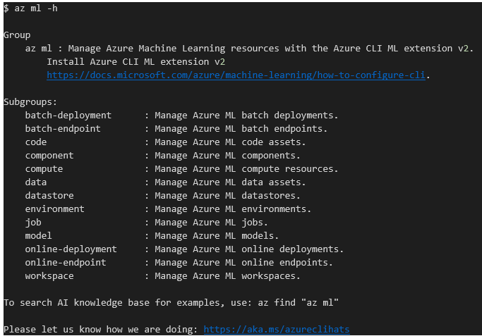
CLI v2

Slide 37

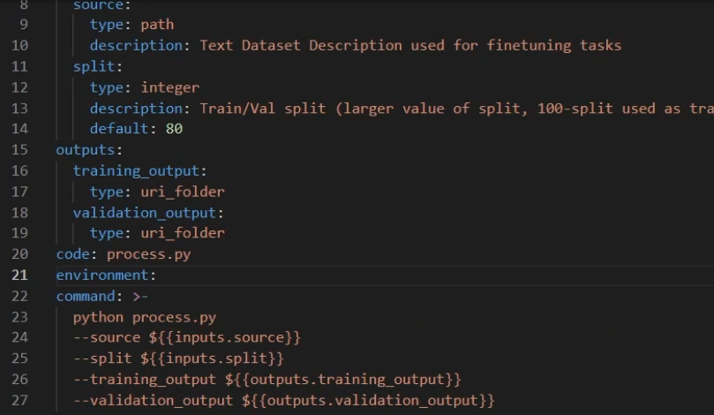
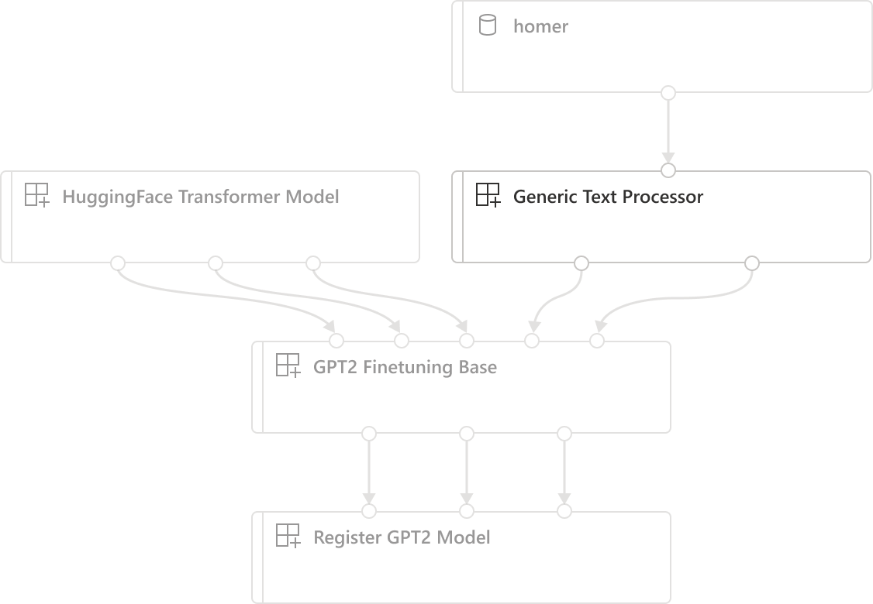
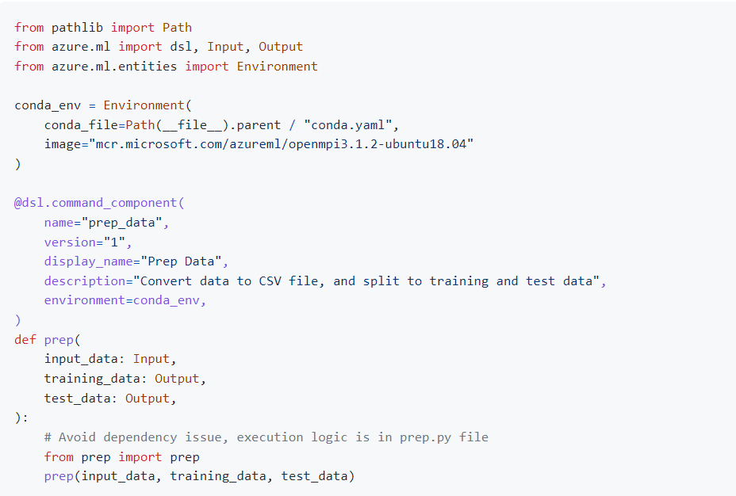
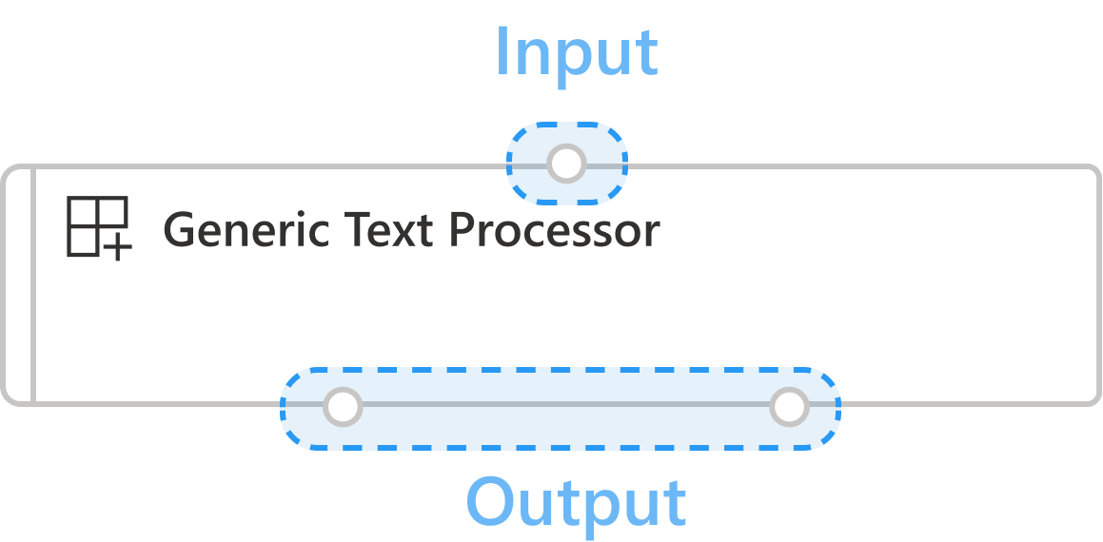
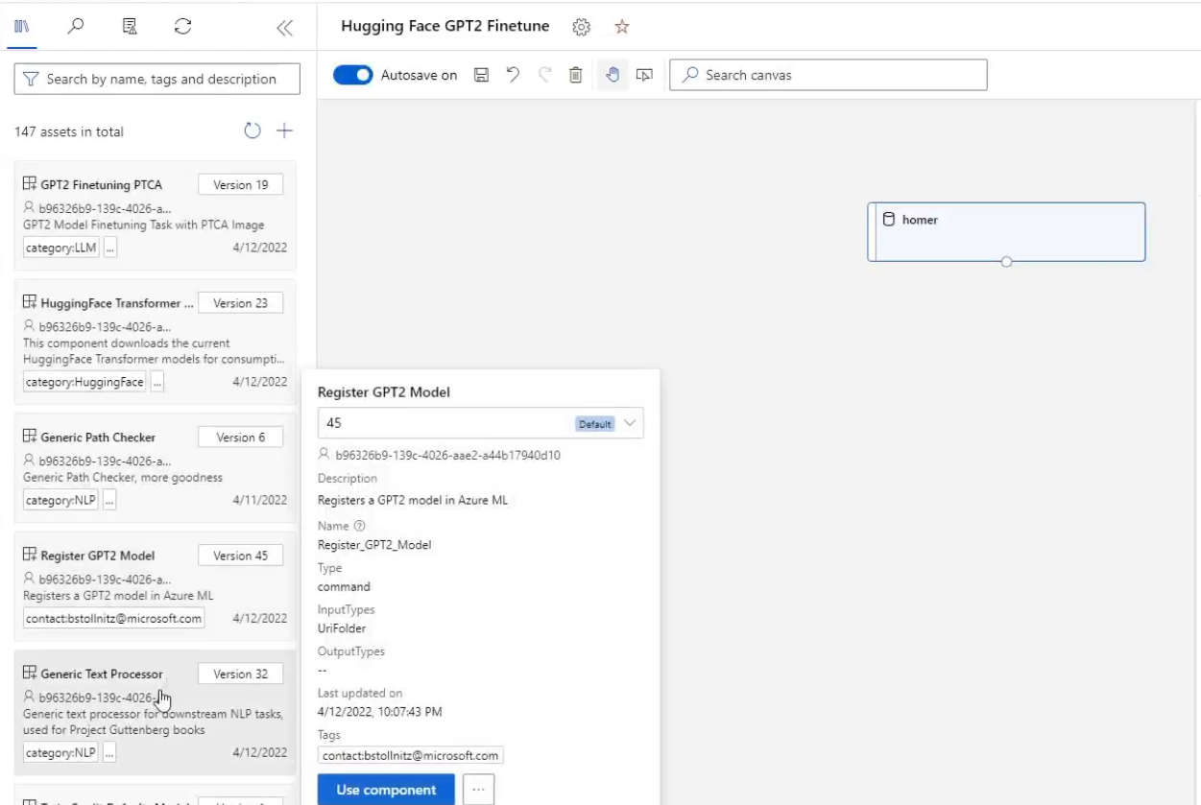
Custom components
03.03
Pipeline
CLI
Metadata name, display_name, version, type, etc.
Interface input/output specifications (name, type, description, default value, etc).
Command, Code & Environment command, code and environment required to run the component
SDK
UI

Slide 38

Medium close-up for large graphics containers mockup
05.01
Announcing
Azure Machine Learning
Generally Available Soon
Arc support
Generally Available
Managed endpoints
Preview
Python SDK v2
Generally Available
Command Line Interface v2
Custom reusable components (in pipelines)
Preview
Responsible AI Dashboard & Responsible AI Scorecard
Preview

Slide 39

Medium close-up for large graphics containers mockup
05.02
Announcing
Azure Machine Learning
Automated ML new features
Support for natural language processing and image tasks
Generation of model training codes
Enhancements for product integration and MLOps
Preview
Preview
Preview

Slide 40
Medium close-up for large graphics containers mockup
05.03
Announcing
Azure Machine Learning
Integration with RStudio Workbench
Preview

Slide 41
05.04
Announcing
Azure Machine Learning
Generally Available Soon
Automated ML new features
Support for natural language processing and image tasks
Generation of model training codes
Enhancements for product integration and MLOps
Arc support
Generally Available
Managed endpoints
Preview
Preview
Python SDK v2
Preview
Generally Available
Command Line Interface v2
Custom reusable components (in pipelines)
Preview
Preview
Responsible AI Dashboard & Responsible AI Scorecard
Integration with RStudio Workbench
Preview
Preview

Slide 42
Azure Machine Learning
Accelerate the end-to-end machine learning lifecycle
Improve time-to-value with rapid innovation and integrated tools
Operationalize at scale with MLOps
Develop on a secure, hybrid and compliant platform
Deliver responsible solutions

Slide 43


.NET
Your platform for building anything
Desktop
Web
Cloud
Mobile
Games
IoT
AI

Slide 44
.NET 6 adoption
Active users by version
(month since release)
1.8x
>5.6M total

Slide 45
Generally available
.NET 6
Unified common base libraries & SDK
Industry leading performance
Hot reload everywhere for faster development
Minimal APIs, easier to get started
New C# 10, F# 6 releases
Apple Silicon (Arm64) support
Long-Term Support Release
get.dot.net/6

Slide 46
Modern client development
with .NET

Slide 47
Client development is important
>1B
Windows 10 & 11 devices worldwide
>4B
iPhone & Android devices worldwide
Sources: blog.google/products/android/android-12-beta/ ; www.imore.com/apple-earnings-call-transcripts-q1-2021 ;

Slide 48
Generally available
.NET Multi-platform App UI
Cross-platform, native UI with C# and XAML
Single project system, single codebase
Access native device capabilities
Develop quickly and iteratively with Visual Studio
Available with:
Visual Studio 2022 17.3 Preview 1 ​
Visual Studio 2022 for Mac 17.3 Preview 1​
dot.net/maui

Slide 49


.NET MAUI in .NET 6
One Base Class Library
Type Unification
CLI Support
SDK Style Projects
Modern Support Lifecycle
Unified .NET
.NET 6
.NET MAUI
Mobile, desktop, hybrid
Android
iOS
WinUI
Mac Catalyst
Blazor WebView
WinUI
Mac
Catalyst
iOS
Android
Single Project
Microsoft.Extensions
.NET Hot Reload
XAML Hot Reload
Visual Diagnostics
Productive development
macOS
iOS

Slide 50
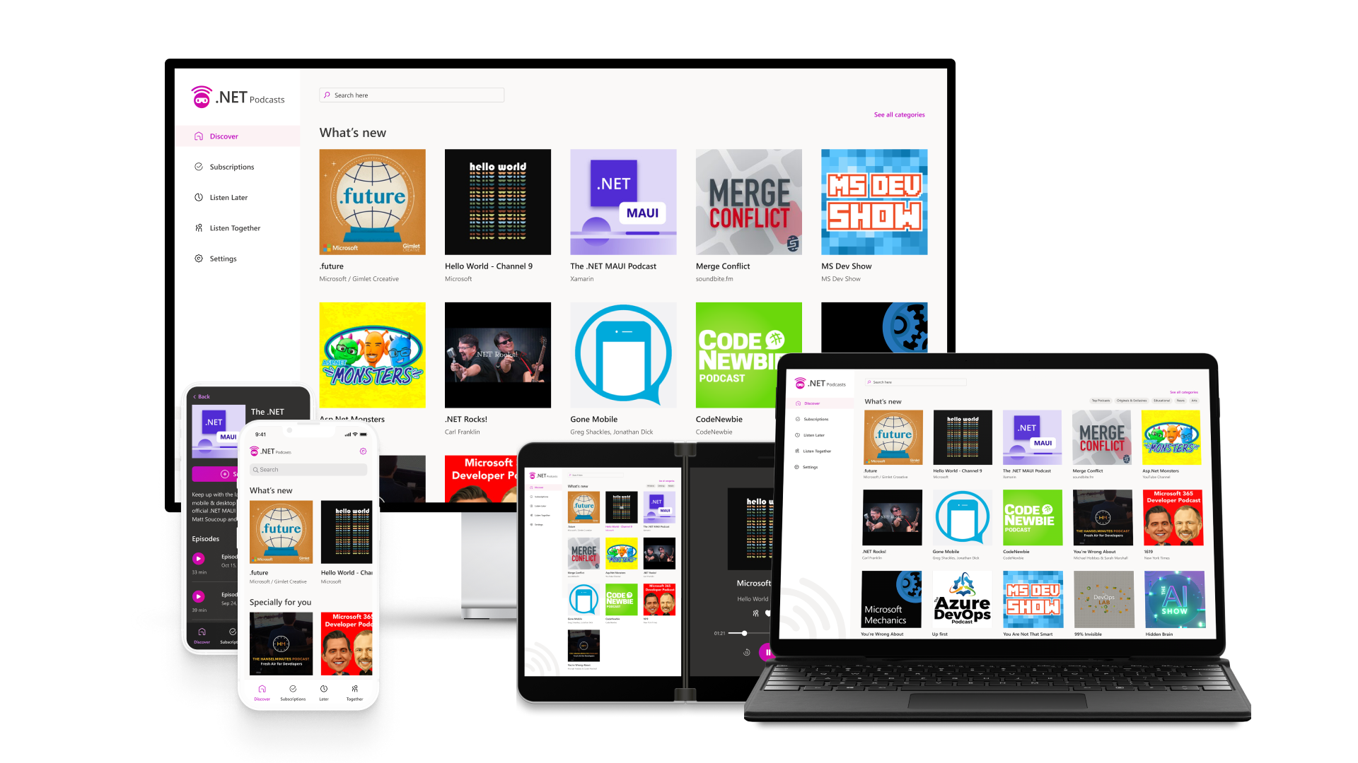
github.com/microsoft/dotnet-podcasts

Slide 51









.NET MAUI
Azure Container Apps
Azure Storage
Podcast.API
Feed Queue
Podcast.Ingestion
Hybrid App
Podcast.Updater
BLAZOR WASM
Azure App Service Linux
Azure SQL
Pages
SignalR
Listen Together Component
Podcast DB
Listen Together Hub
App Service Web App
Web Browser
ListenTogether DB
Podcast server

Slide 52

Blazor
Full stack web apps with .NET

Slide 53
Generally available
Hybrid apps with Blazor & .NET MAUI
Reuse UI components across native and web
Native app container & embedded controls
Built on top of .NET Multi-platform App UI
Available with:
Visual Studio 2022 17.3 Preview 1 ​
Visual Studio 2022 for Mac 17.3 Preview 1​
dot.net/maui

Slide 54
Choose your stack
BLAZOR
BLAZOR + .NET MAUI
.NET MAUI
C#, HTML, CSS
C#, XAML
Reach
Power
Site
PWA
Electron, CEF
Native App
with WebView
Native App
Web
Hybrid
Native

Slide 55








Components & Controls Available for .NET MAUI & Blazor today

Slide 56
.NET 6 support in Azure day zero
Azure App Service
All regions
Both Windows and Linux
Azure Static Web Apps
Blazor WebAssembly with AOT
.NET 6 Azure Functions APIs
Azure Functions
Azure Functions runtime 4.0
Both in-process and isolated models

Slide 57




Common App Patterns
N-tier (scalable web apps)
Microservices
Frontend
Components
Frontend
Components
Frontend
Components
Frontend
Backend
Data
Service (Orders)
Service (Inventory)
Service (Customers)
Data
Data
Data

Slide 58

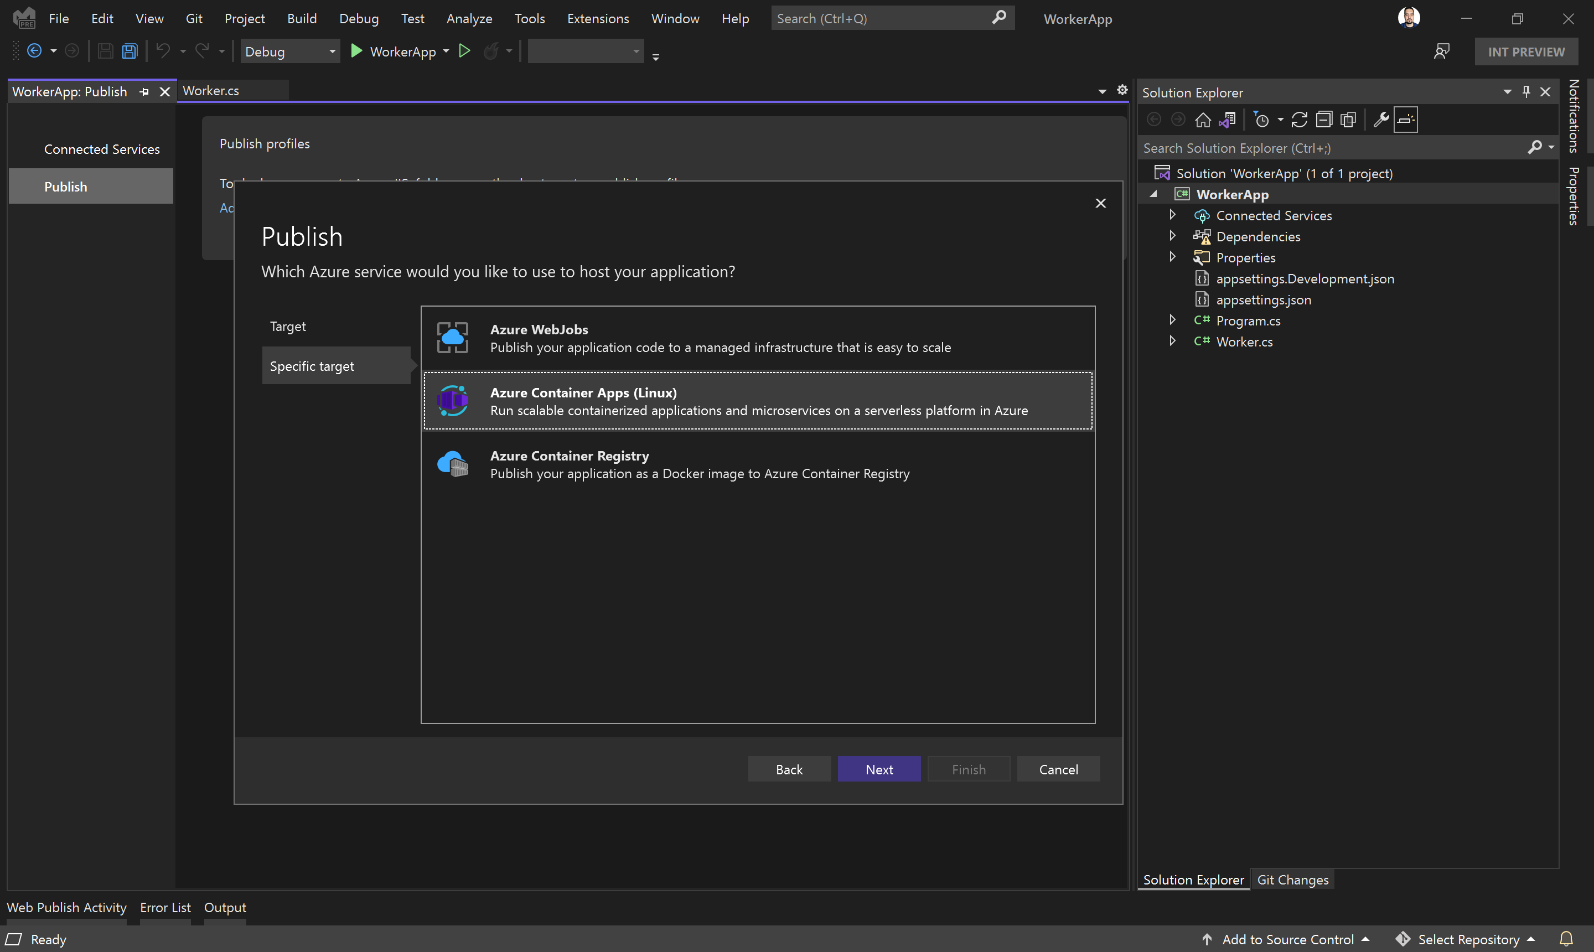




Generally available
Azure Container Apps
Serverless containers for microservices
ASP.NET web APIs & minimal APIs
Worker Service for background services
Publish from Visual Studio 2022
Build modern apps on open source
Focus on apps, not infrastructure
Seamlessly upgrade to Kubernetes
Kubernetes
KEDA
Dapr
Envoy

Slide 59
Generally available
Azure Container Apps
Serverless containers for microservices
ASP.NET web APIs & minimal APIs
Worker Service for background services
Publish from Visual Studio 2022
Kubernetes
KEDA
Dapr
Envoy

Slide 60
Visual Studio + GitHub Azure
Focus on apps, not infrastructure
Seamless code to cloud
Any language, any platform
Secure build, test, and deployment

Slide 61

Code to cloud with GitHub
Visual Studio 2022 provides first class Git and GitHub integration
GitHub Actions gives you powerful CI/CD for .NET MAUI apps, Azure apps, and more
Public Preview:
GitHub Advanced Security includes secret scanning push protection
Actions Job Summaries allows you to create detailed workflow results

Slide 62
Public preview
.NET 7 Preview 4
Streamlined SDK
Native AOT compilation
Central Package Management
Minimal API, gRPC enhancements
More performance improvements
get.dot.net/7

Slide 63
Announcing
.NET Conf 2022
November 8 – 10
.NET 7 launch
Free, three-day, virtual event
Save the date!
www.dotnetconf.net

Slide 64
Get started today!
Get started with .NET MAUI
dot.net/maui
Download Visual Studio 2022
VisualStudio.com/download

